Slide 1
The diverse bride
A story about
Jenny’s wedding plan

Slide 2

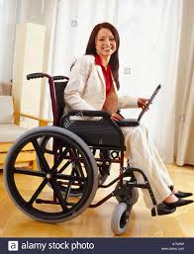
Hi I am Jenny!

Slide 3
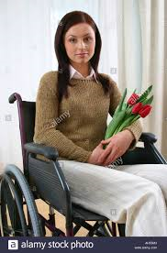
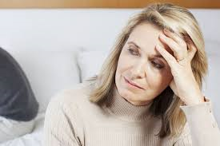
Mom, I have something to share….
Anything special Jenny?

Slide 4
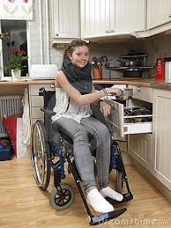

I think I am ready to get married
Really!!!
Oh I was waiting for this for so long!
I am excited
I can’t wait to share this news with my friends

Slide 5
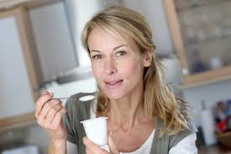

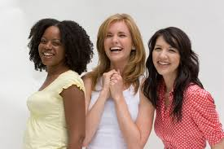
Hey last night my daughter broke the news, She and her long time boyfriend Dan decided to get married. I am so excited!
Hey, Lets start planning for the wedding!
That’s wonderful!

Slide 6
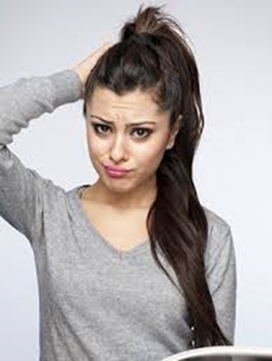
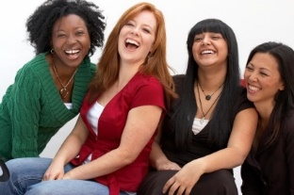
Jenny what theme you have in mind?
Not sure….
Any suggestions!
Lets go a bit crazy…

Slide 7
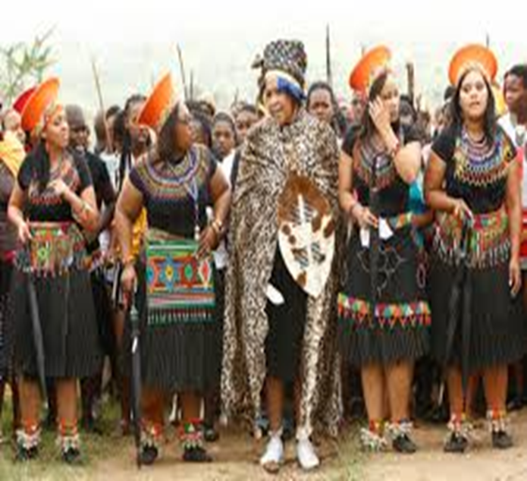
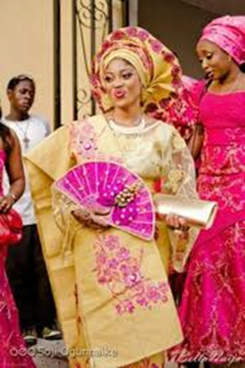

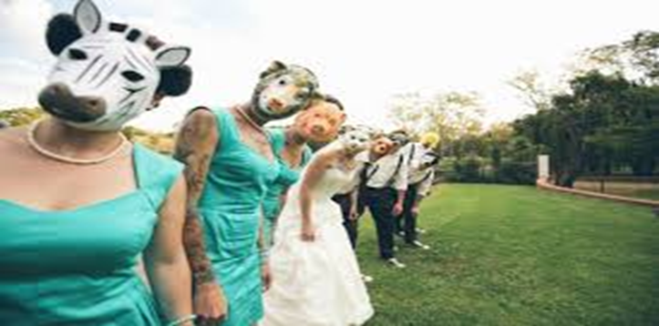
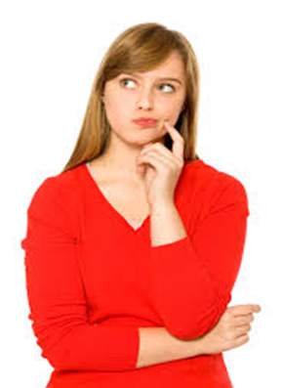
African wedding theme is very colourful. Have you thought about the African bridal style?

Slide 8


Slide 9
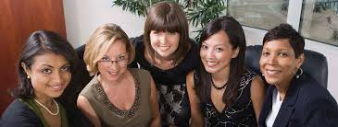
Jenny Go for a Italian wedding theme.
Fabulous food….Yumm
A Chinese wedding style would be totally new idea
Latino wedding could be fun….

Slide 10
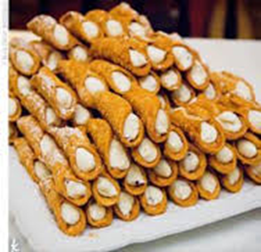
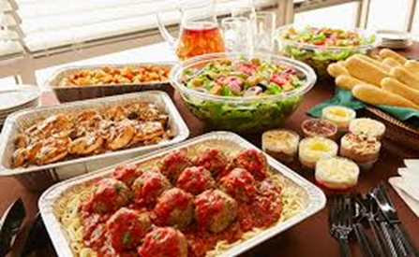
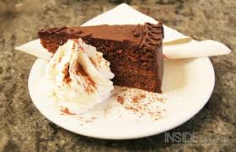
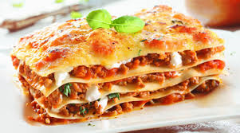

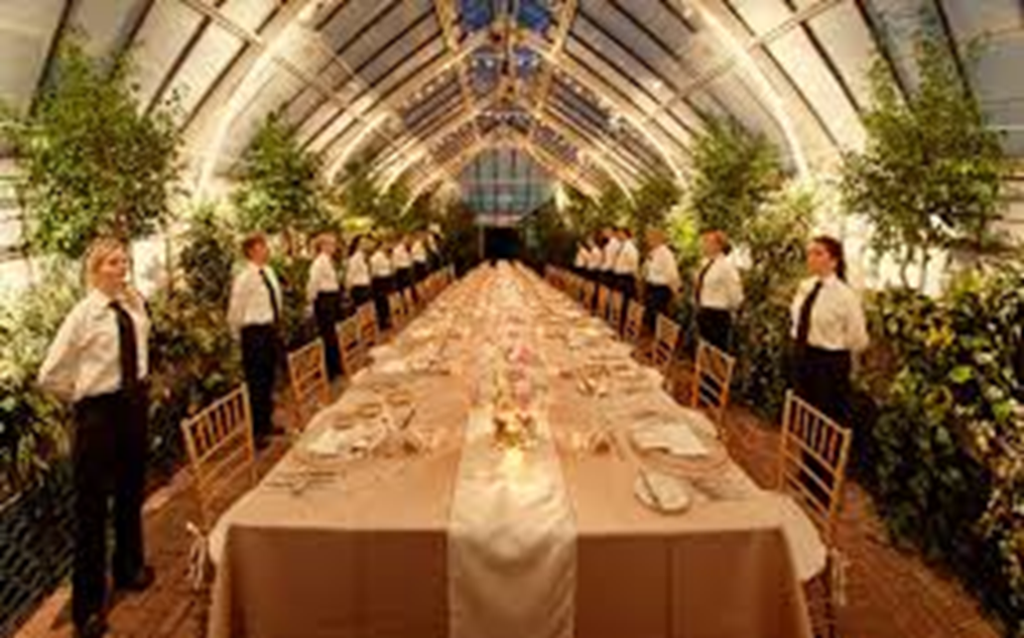
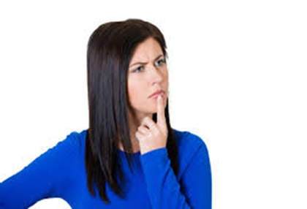

Slide 11
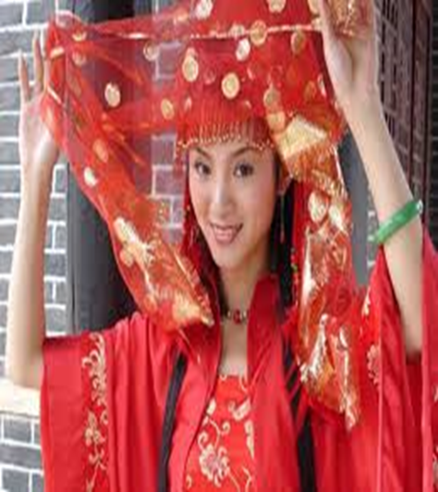
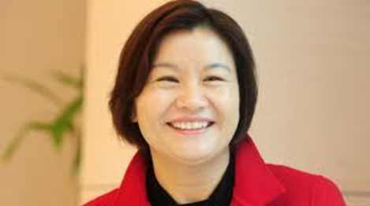

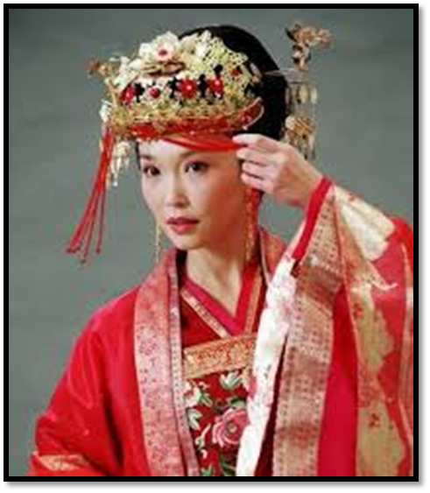
Chinese bridal makeover will suit you
I like there wedding suit with beautiful embroidery. Hmmm.. but its only red..
Everything Red and Gold…lovely combination

Slide 12
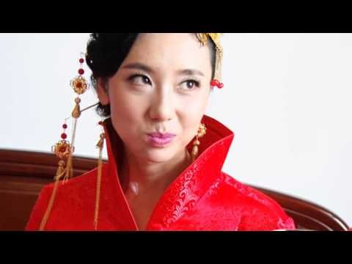
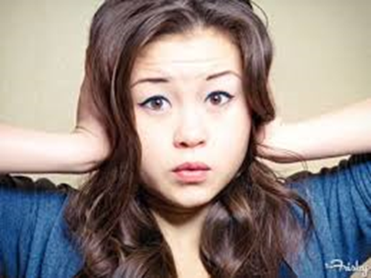
*****

Slide 13
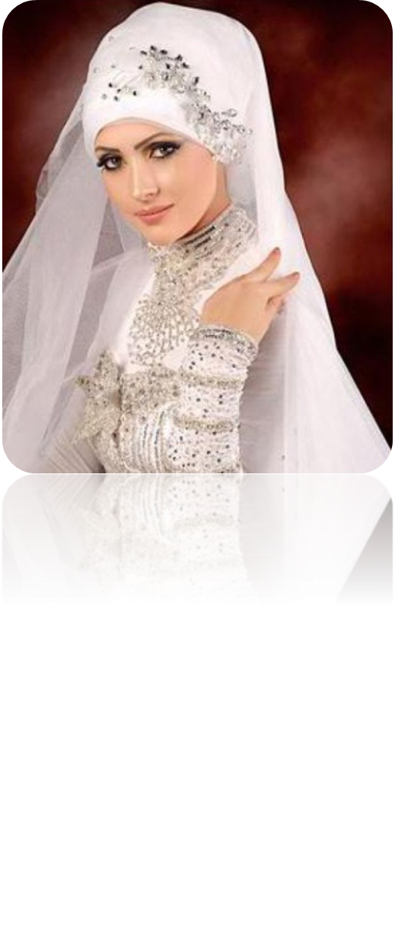
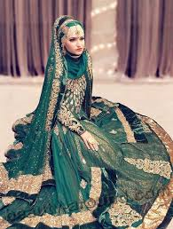
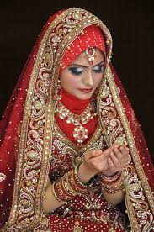
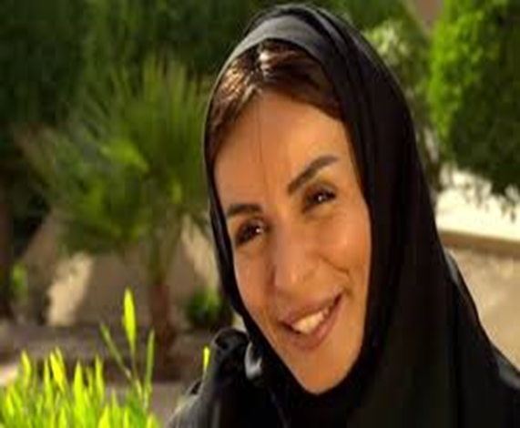
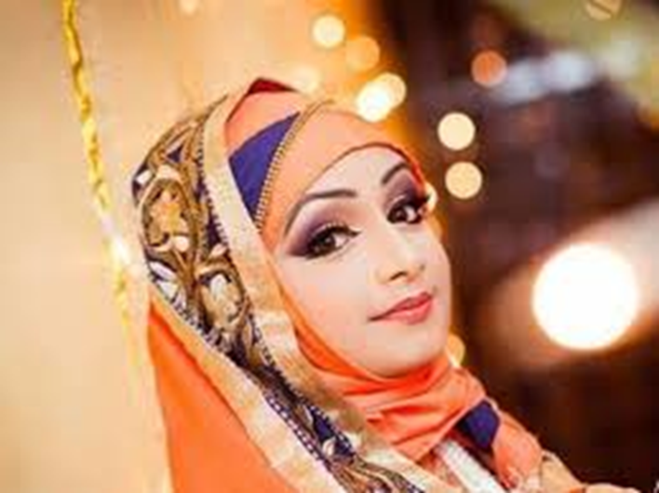
Lebanese bridal wear is colourful and they have nice jewellery on.

Slide 14
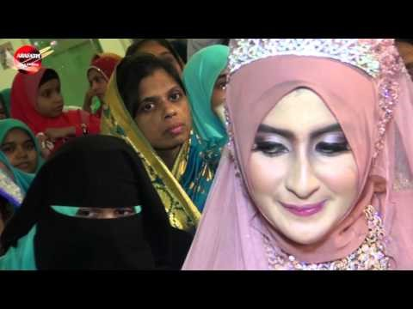

Slide 15
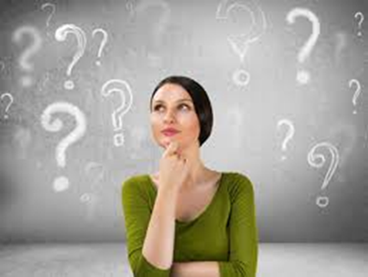
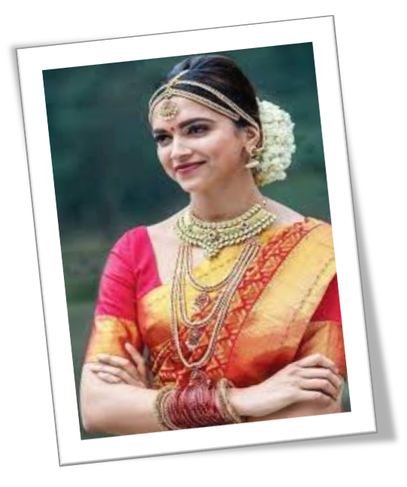
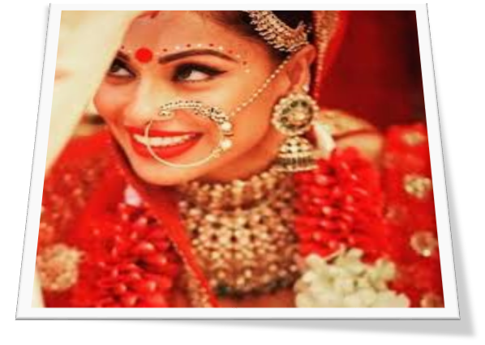
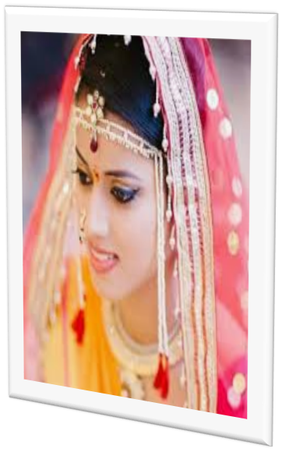
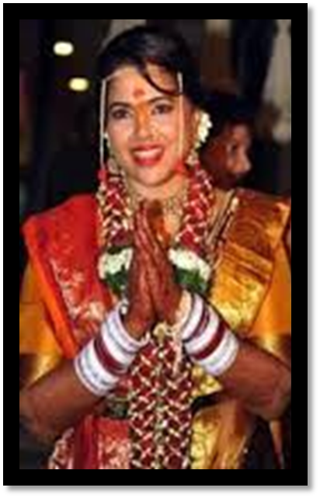
Well Indian theme has everything, colours, jewellery, music and delicious food too!

Slide 16
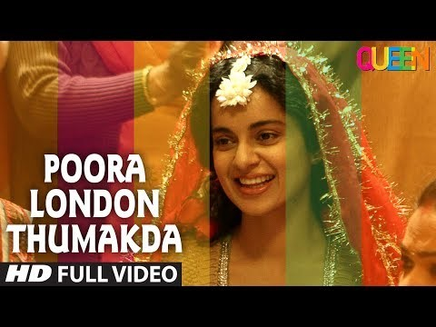

Slide 17

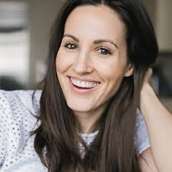
Mom I have all kinds of friends. I have friends from different cultures and I am inviting all of them. So…..it is going to be a fusion wedding. I want my friends to be a part of my wedding .
I LIKE IT…Fusion wedding

Slide 18
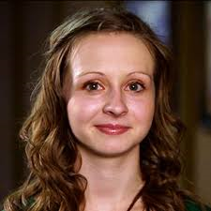
I WANT COLOURS, FOOD, SILKY TOUCH OF THE WEDDING GOWNS, MUSIC AND LOTS OF FRIENDS TO SEE MY BEGINNING OF NEW LIFE WITH MY LOVE

Slide 19
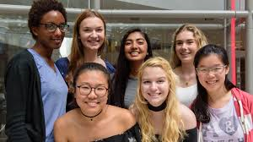
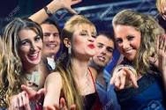
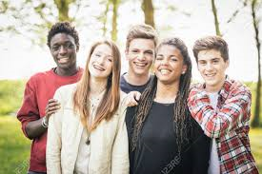
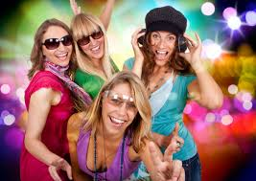


Slide 20
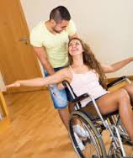
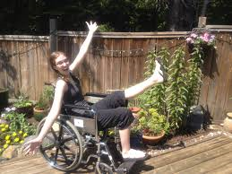

Slide 21
